Slide 1
Classification of Alzheimer’s and Dementia Subtypes Using
R-STDP Driven Spiking Neural Networks
,

Slide 2
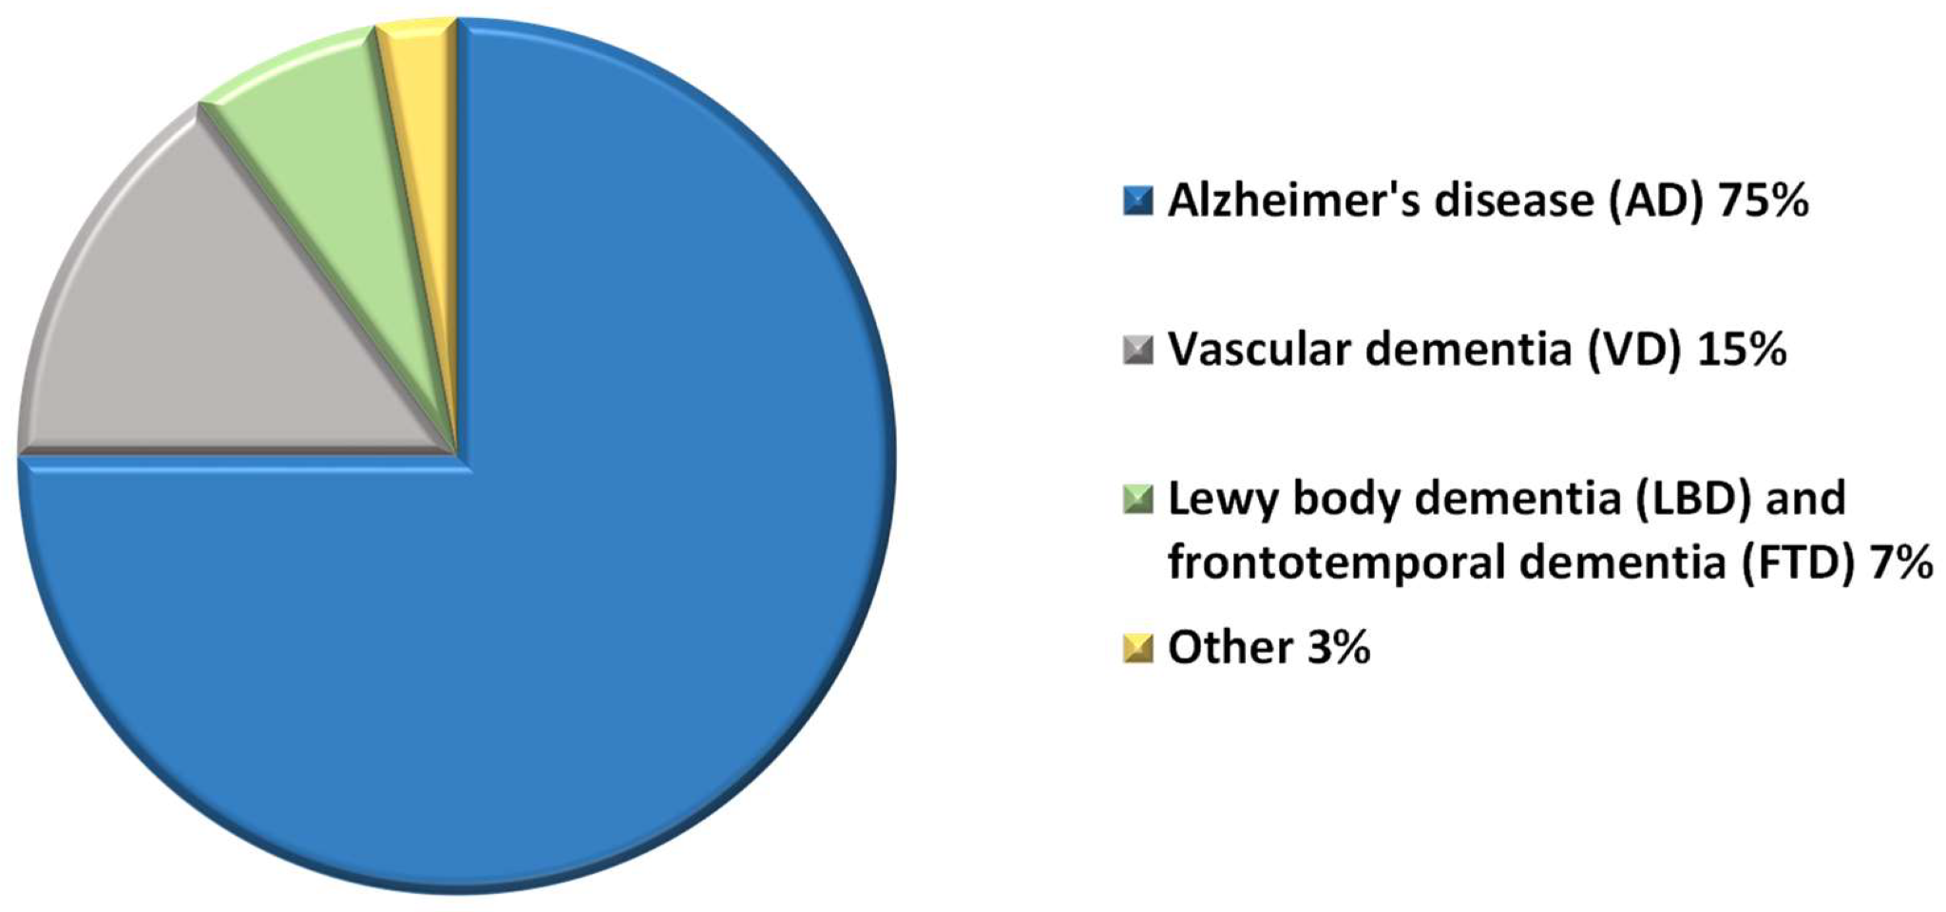
Significance of our research
Current research gaps that we addressed
Current diagnostic methods — slow, subjective, and resource-intensive
Traditional deep learning models — computationally expensive and energy-inefficient
Biologically implausible

Slide 3
Literature Review
Classification of Alzheimer’s Disease Using Deep Convolutional Spiking Neural Network
Spiking Neural Networks for Multimodal Neuroimaging: A Comprehensive Review of Current Trends and the NeuCube Brain-Inspired Architecture
Main contributions:
Integrating SNN with CNN for Alzheimer’s detection.
Using unsupervised spike pre-training to extract Alzheimer’s features before supervised learning.
Application of time-to-first-spike temporal encoding, enabling biologically inspired spike-based feature learning.
Accuracy up to 90.15%
Main contributions:
Introduced NeuCube as a 3D brain-inspired SNN framework
comparative evaluation of SNN software and hardware platforms
97% accuracy in epilepsy and cognitive state classification
Garcia-Palencia et al., Spiking Neural Networks for Multimodal Neuroimaging: A Comprehensive Review of Current Trends and the NeuCube Brain-Inspired Architecture. Bioengineering, 2025
R. E. Turkson et al., “Classification of alzheimer’s disease using deep convolutional spiking neural network,” Neural Processing Letters, 2021.

Slide 4
Problem Statement
Existing Research shortcomings:
Designing a model to address the challenges of early detection of subtle neurostructural alterations caused by dementia and Alzheimer’s disease using a neuromorphic feature extraction framework integrating temporal spike encoding with Forward-Forward learning to enable efficient and accurate classification.
High training complexity
High computational complexity
Poor performance of SNNs on static MRI data compared to CNNs

Slide 5
Novelty
Biologically inspired
neuromorphic design
R-STDP - driven
Spiking Autoencoder
Temporal spike encoding
of MRI images
Energy-efficient and
event-driven computation

Slide 6
Data Collection
Our research utilized two main sources of MRI data.
Publicly available MRI scans (secondary data) were used for the majority of model development and training.
Includes pre-labeled grayscale images categorized by disease states.
In addition to the secondary data, a primary dataset of MRI scans were collected from a collaborating hospital.
This data was collected by following full institutional approval and ethical guidelines.

Slide 7
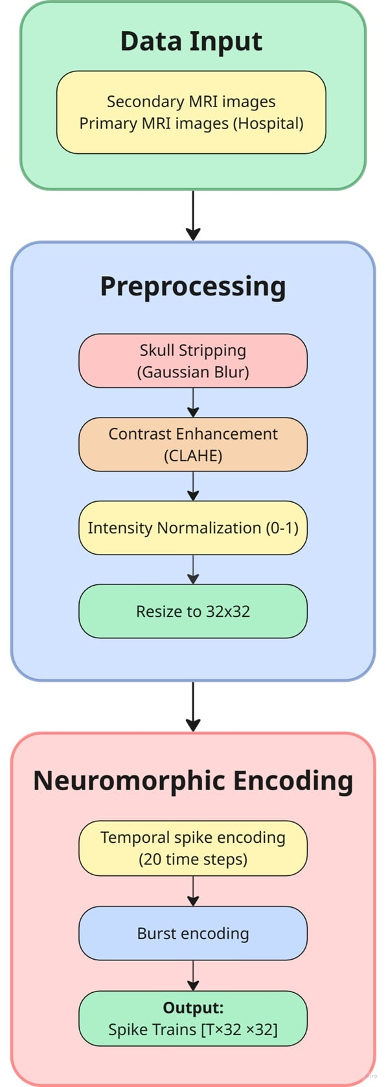
Data Processing
Robust Data processing pipeline to prepare MRI scans for analysis:
Grayscaling of primary data
Skull stripping for removing non brain tissues from the MRI scans and isolating the brain region
Denoising using Gaussian filtering, Otsu thresholding for brain segmentation, morphological operations to remove small and unnecessary artifacts from images.
Noise reduction and contrast enhancement using CLAHE
Normalization to standardize the range of pixel intensity values across all images

Slide 8
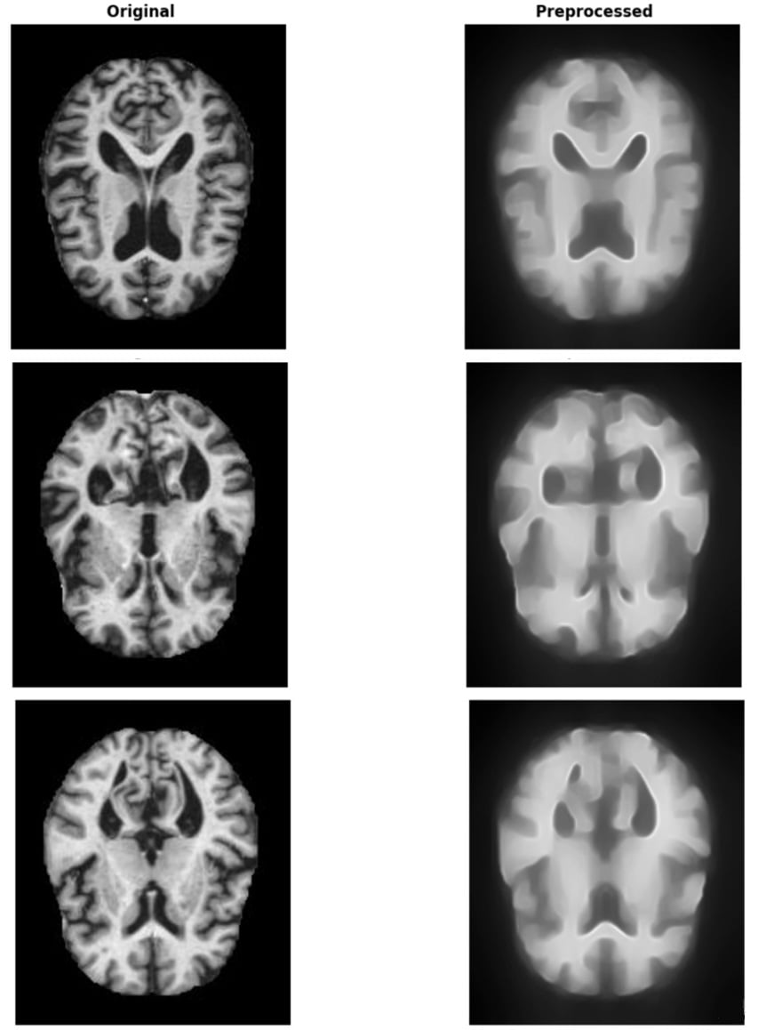

Data Processing
Preprocessed images converted to spike trains using Temporal
Encoding. Implements an intensity-to-timing mapping where higher pixel intensities generate earlier spike times.
Each image resized to a standard 32x32 pixel format.
Random weighted sampling used to overcome class imbalance in datasets and ensure each class was represented adequately during training.
Fig: Original scans vs Preprocessed scans

Slide 9
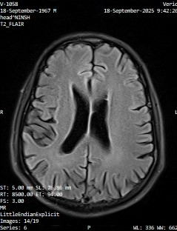
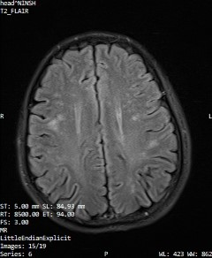
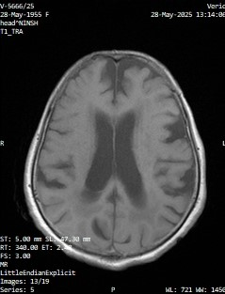
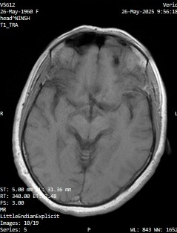
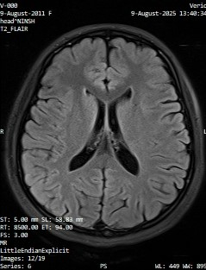
Primary Dataset
Brain MRI scans collected in CDs (DICOM format)
Collaborating hospital: National Institute of Neurosciences and Health, Agargaon
Data validation by neurologist
Enlarged ventricle
Tissue discoloration
Atrophy(brain tissue shrinkage)
Normal Brain scan

Slide 10
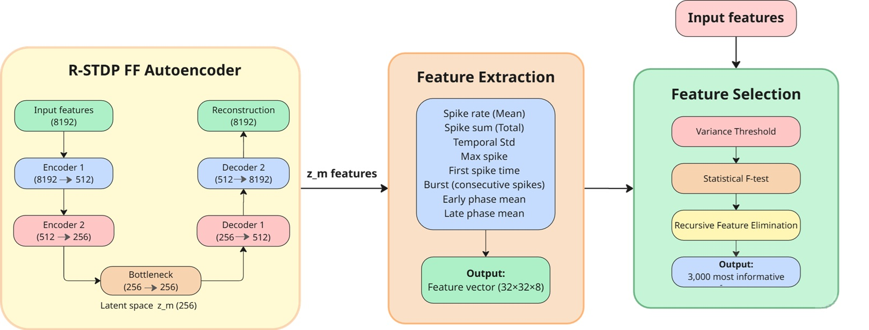
FF + RSTDP SNN Autoencoder Model Architecture
classification of demented vs non demented from structural MRI
no backpropagation

Slide 11
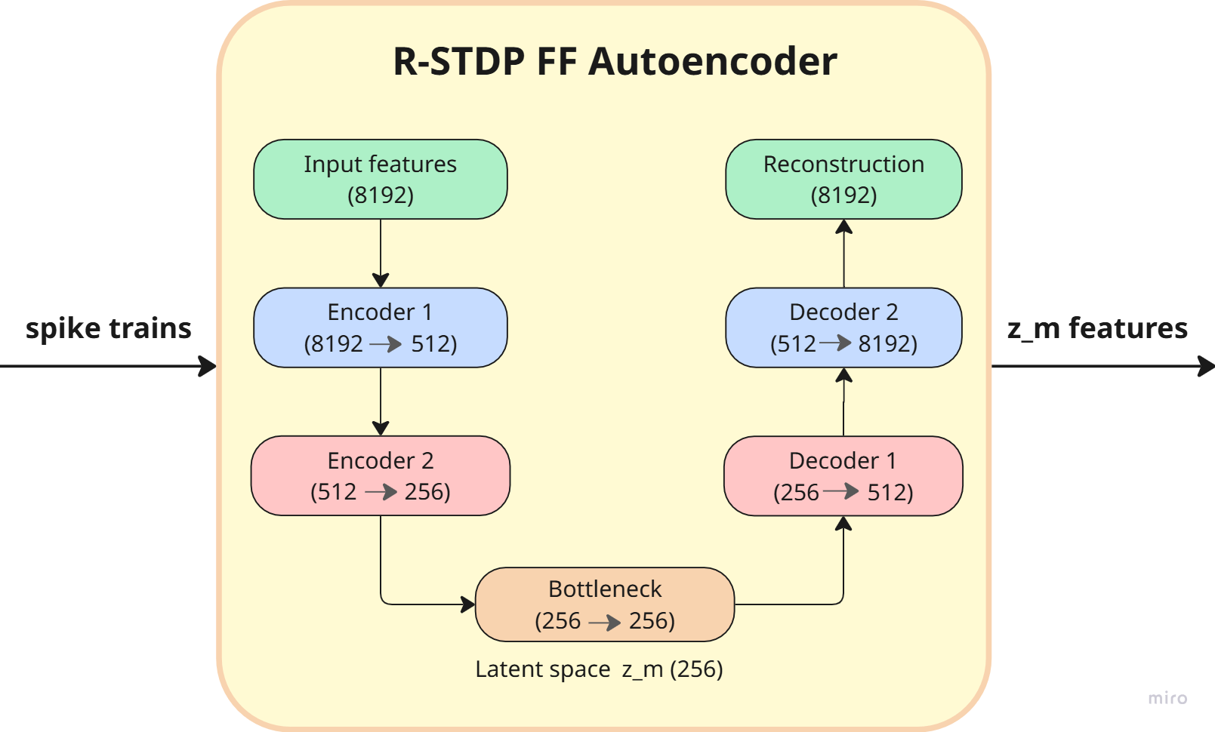
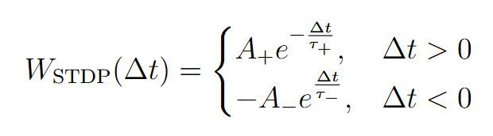
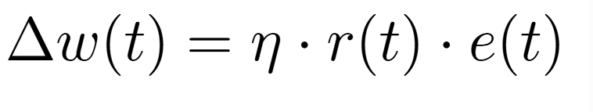
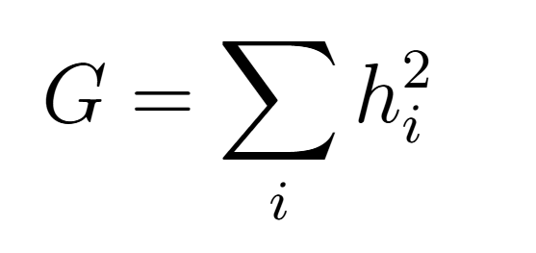
R-STDP FF Autoencoder
Reward-modulated STDP
Synaptic changes depend on spike timing and task performance
Positive reward for good output (accuracy of reconstruction)
Forward-Forward Learning (FF)
Positive data: if goodness < threshold, increase weight
Negative data: if goodness > threshold, decrease weight
Each layer maximizes goodness for +ve data, minimizes for -ve
No backpropagation or global error signals
R-STDP weight update:
Autoencoder
Goodness score:
Compresses high-dimensional input to a bottleneck
Latent space (bottleneck) captures most informative features

Slide 12
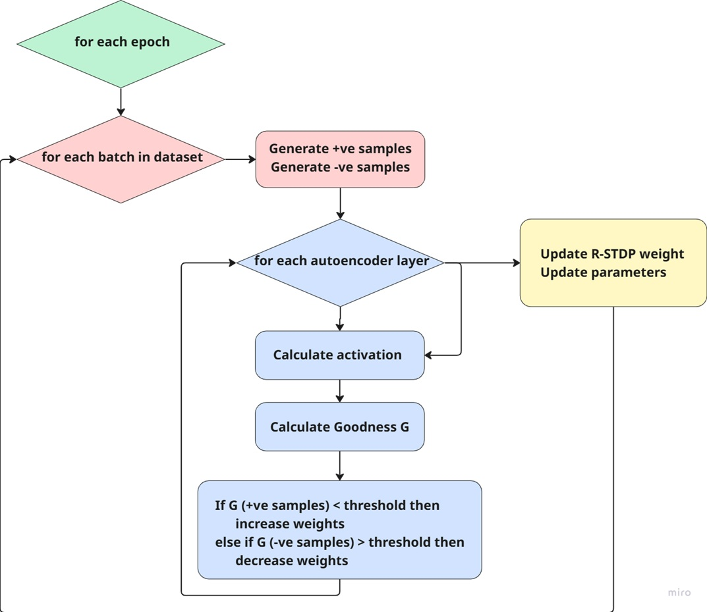
Training algorithm

Slide 13
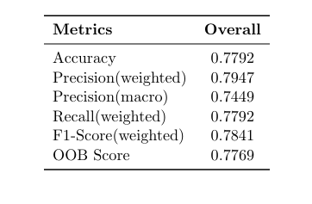
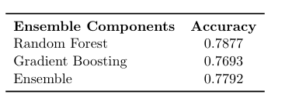
Result Analysis of Proposed Model
Ensemble Classifier for better performance.
Random Forest Classifier with a 78.77% Accuracy and OOB score of 77.69%.
Gradient boosting achieves an accuracy of 76.93%.
Overall Accuracy of 77.92%
Table 2 : Overall System Summary
Table 1 : Overall Performance Evaluation

Slide 14
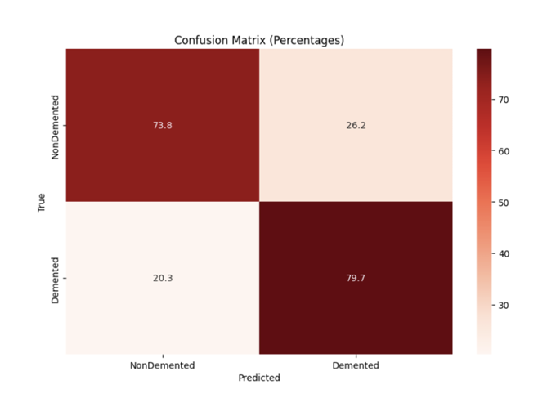
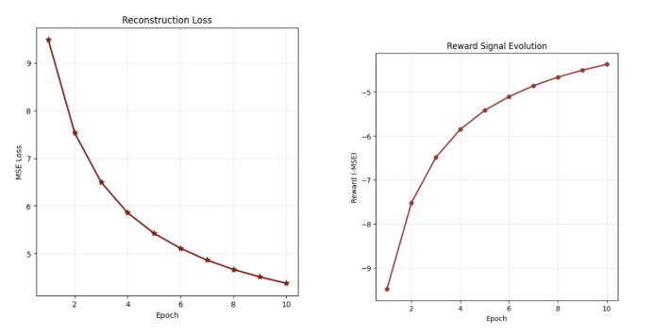
Result Analysis of Proposed Model
Graphs show Reconstruction Loss Decreased, while the Reward Signal Increased
Figure: Confusion matrix of Model
Figure: MSE Loss & Rewards per epochs

Slide 15
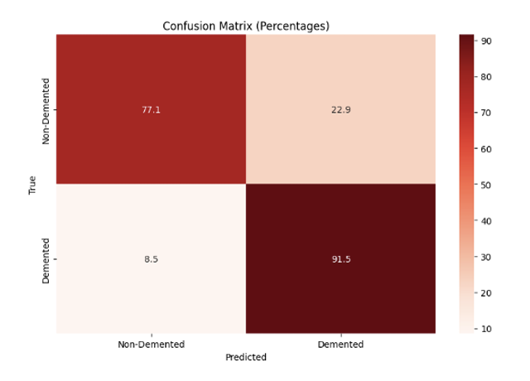
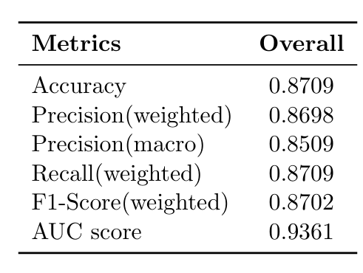
Final Design Adjustments
To improve Feature Extraction, we implemented Transfer Learning
ResNet-50 CNN spatial features obtained and projected to a latent space (z_t)
Fusion with latent space from R-STDP Autoencoder (z_m)
Figure: Confusion Matrix of Fusion Model
Figure: Performance Evaluation of Fusion Model

Slide 16
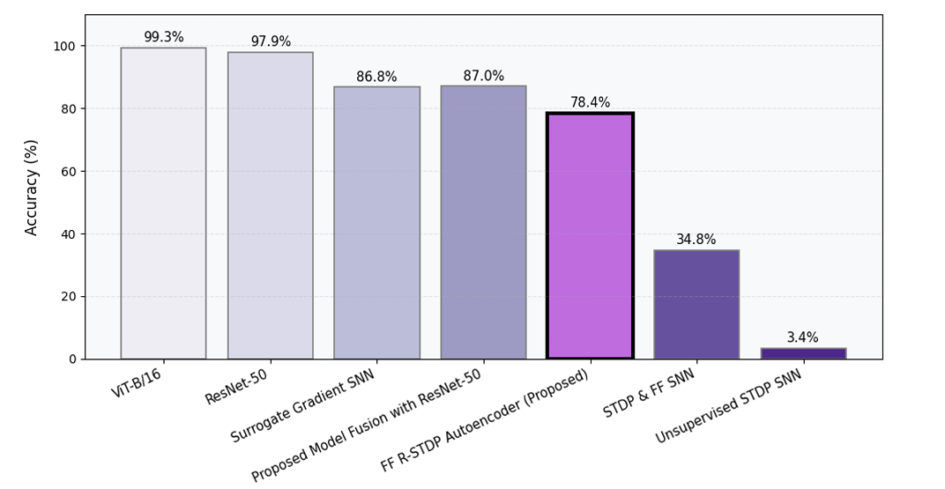
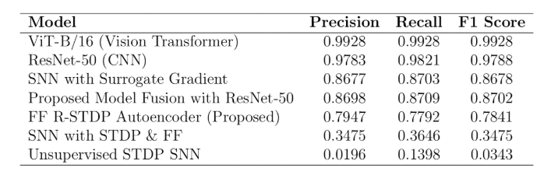
Comparisons

Slide 17
Contributions, Limitations & Future Work
Fundamental improvements:
Energy-efficient R-STDP SNN Autoencoder
Forward-Forward learning combined with R-STDP can replace Backpropagation for feature learning.
Limitations:
Study focused on Binary Classification
Lack of intensive pre-processing used to preprocess MRI scans
Small size of primary dataset
Future work:
Multiclass Classification
Multimodal Classification using synchronous datasets from MRI-EEG patients to detect neurodegenerative diseases such as Parkinson's.

Slide 18
THANK YOU

